Slide 1
Harm Reduction at the Crossroads Drugs, drug policy, harm reduction: A reality check International AIDS Conference July 25, 2018 Amsterdam
Daniel Wolfe
Director, International Harm Reduction Development
Public Health Program
Daniel.wolfe@opensocietyfoundations.org

Slide 2
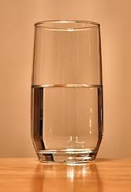
How are we doing?

Slide 3
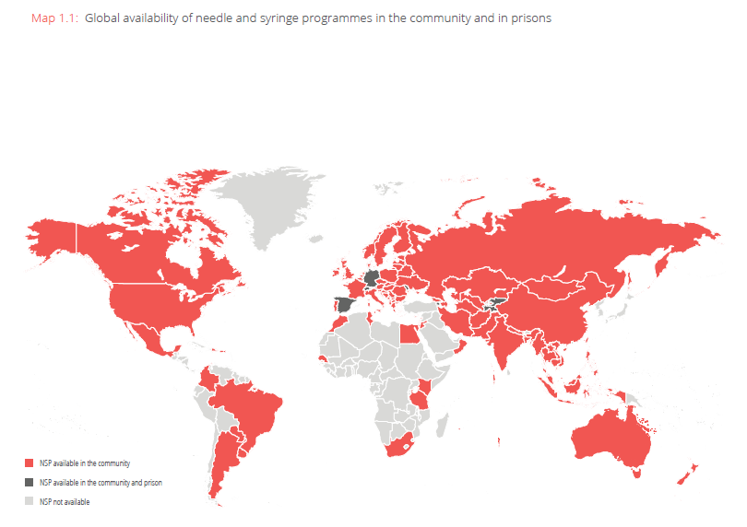
HRI, Global State of Harm Reduction 2016, https://www.hri.global/contents/1739

Slide 4
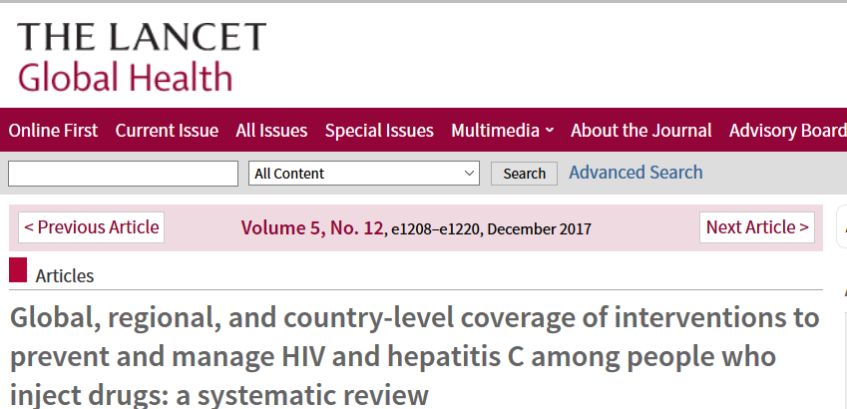
Less than 1% of PWID live in countries with high coverage of both NSP and OST (>200 needle-syringes distributed per PWID and >40 OST recipients per 100 PWID).
Larney S, Peacock A, Leung J, Colledge S et al, 2017

Slide 6
Not how much harm reduction, but how framed?

Slide 7
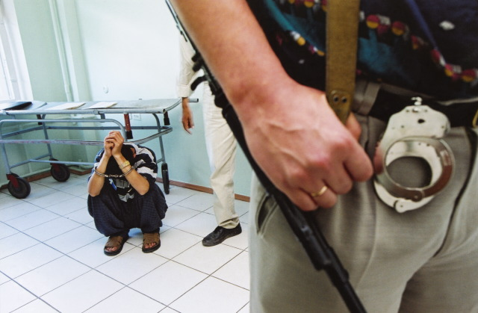
Framing bias #1—Control and Contain
Saying “health issue rather than criminal issue” not enough
Form and language of public health interventions often echo those of enforcement
Photo: Hans-Jurgen Burkard
Notes:
Fingerprinting for methadone treatment; names and IDs for needles and syringes; drug user registries; biometrics for survey duplication—these are among the practices in the countries we singl eout for progress in harm reduction. Those of us trained in public health would do well to listen to our own language to hear what

Slide 8
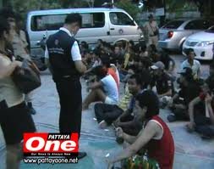
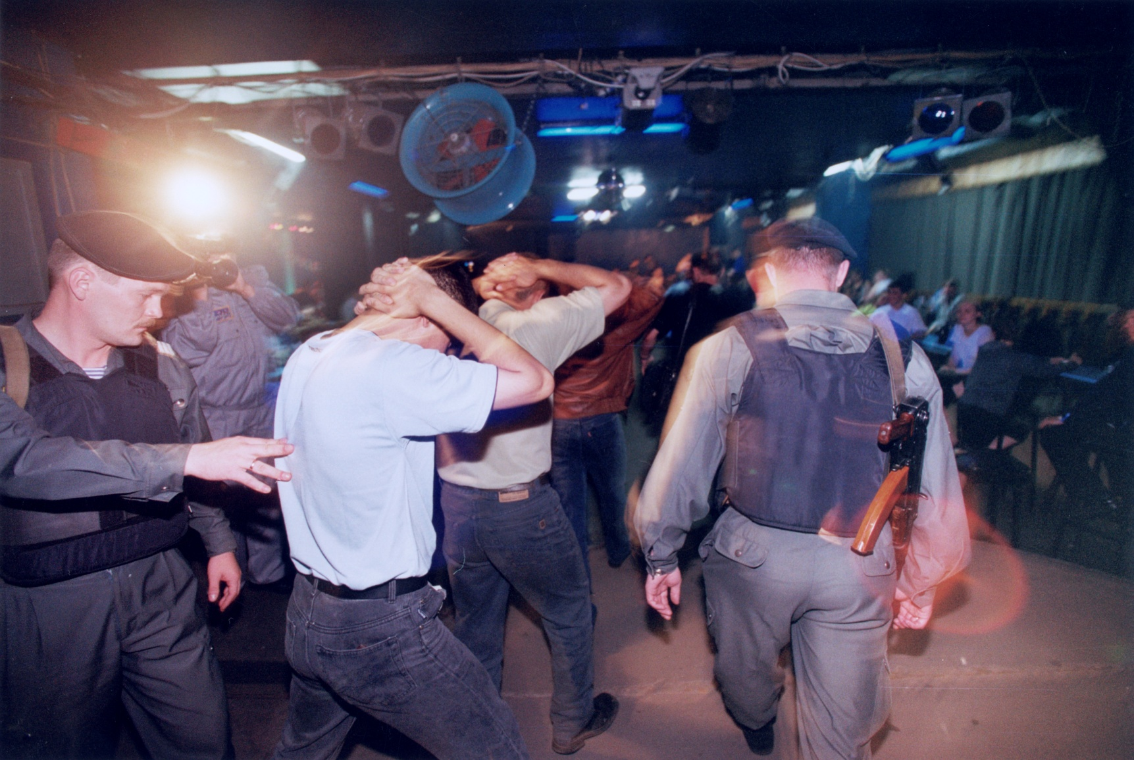
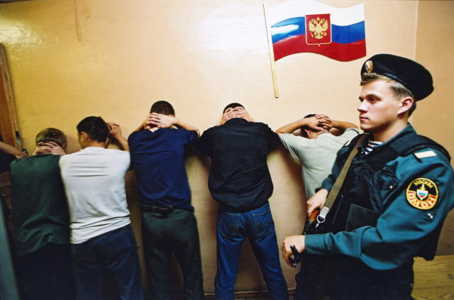
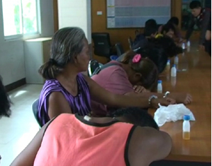
Universal testing

Slide 9
Surveillance

Slide 10
Treatment for All

Slide 11
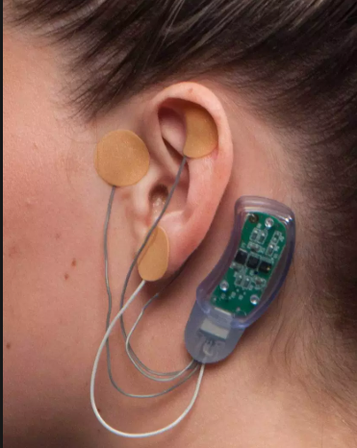
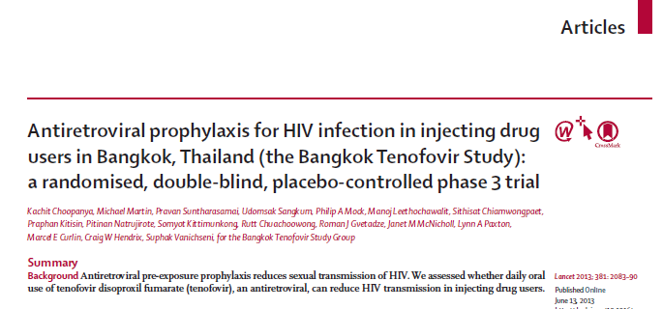
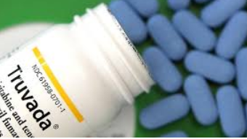
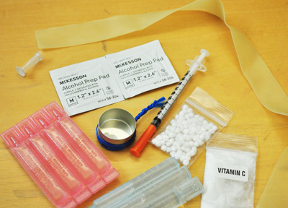
Framing bias #2—Biotechnologies
Notes:
Irony is that those of us working in harm reduction know the limits, since we have a technology that works extremely well to reduce HIV infections to zero--and yet almost never employ it.

Slide 12
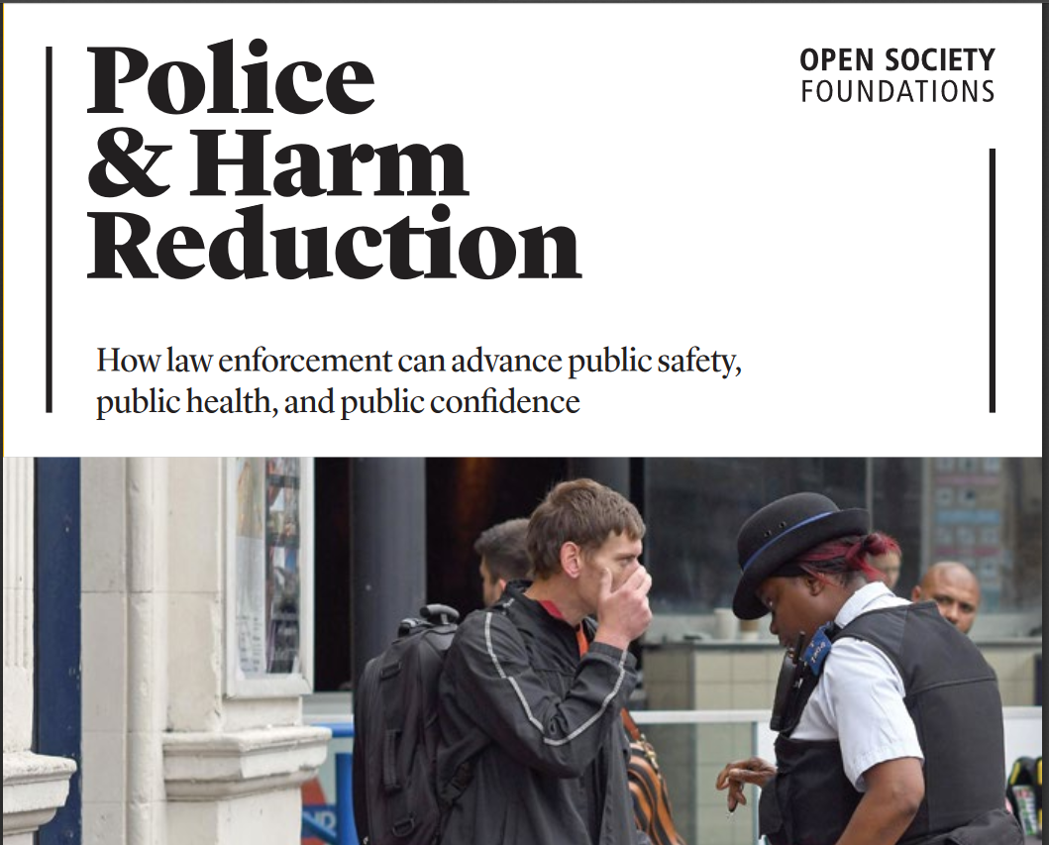
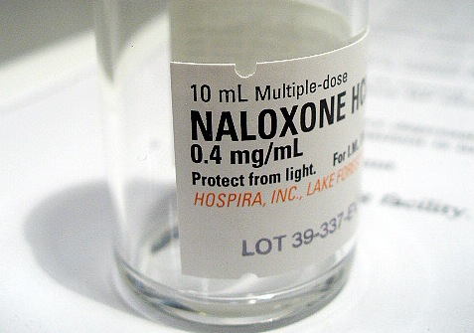
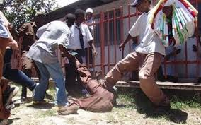
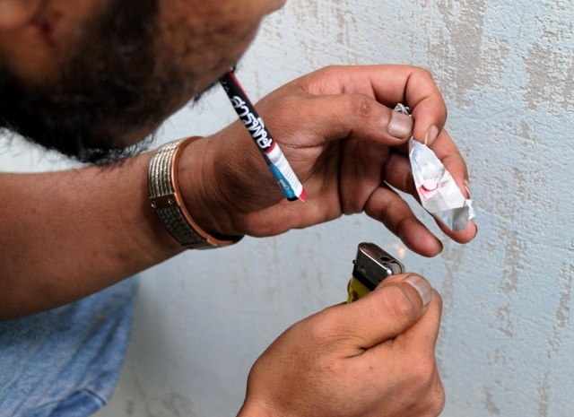
Framing Bias #3: HIV (and abstinence) as outcomes of interest
Notes:
Even if you think, as I do, that it's absolutely critical, improtant to see beyond needles and veins. Stimulant use! Multiple drug use! Overdose! These are what shape people's lives, and so what we if we are interested in saving people's lives, need to attend to. Law enforcement doesn't find drug users hard to reach...precisely because they don't make these distinctions (and have 24 hour outreach)

Slide 13
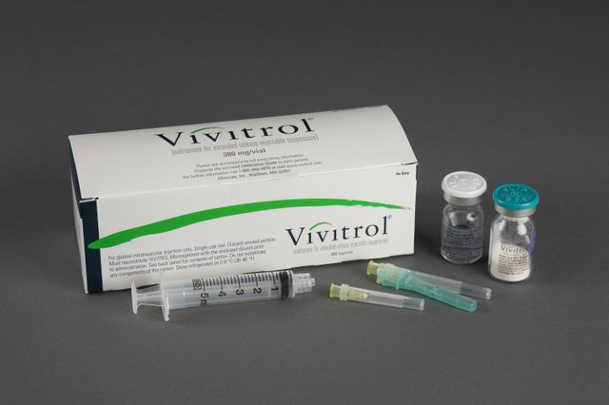
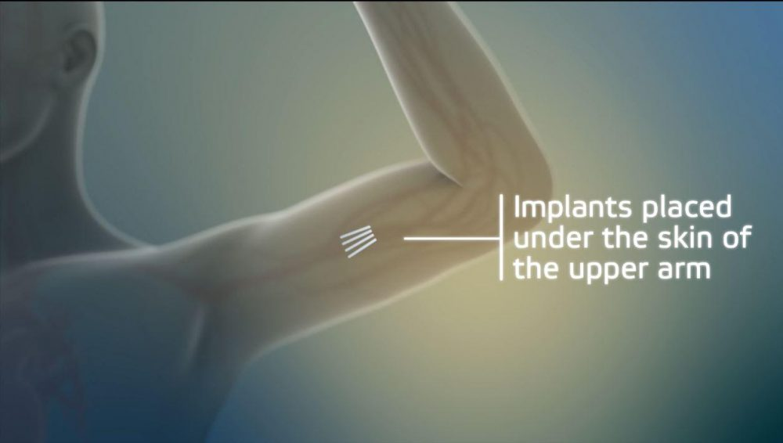
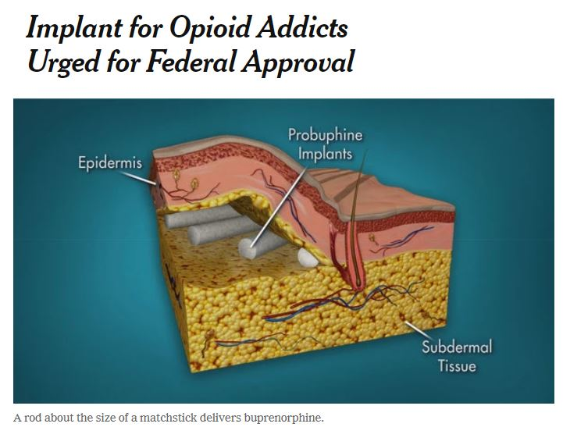
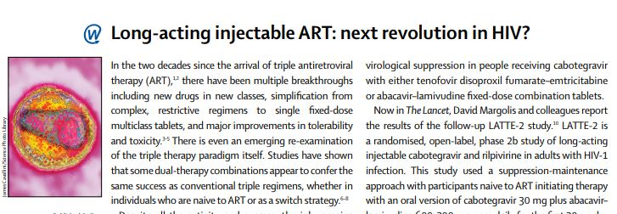
Under our Skin? A future joining all three biases?
Notes:
All potentially useful tools, but also easily abusable by those who would remove patient choice in the name of patient (and provider) convenience. Noticeable that naltrexone--more than 100 times more expensive than methadone--being used now even in countries where resources are limited

Slide 14
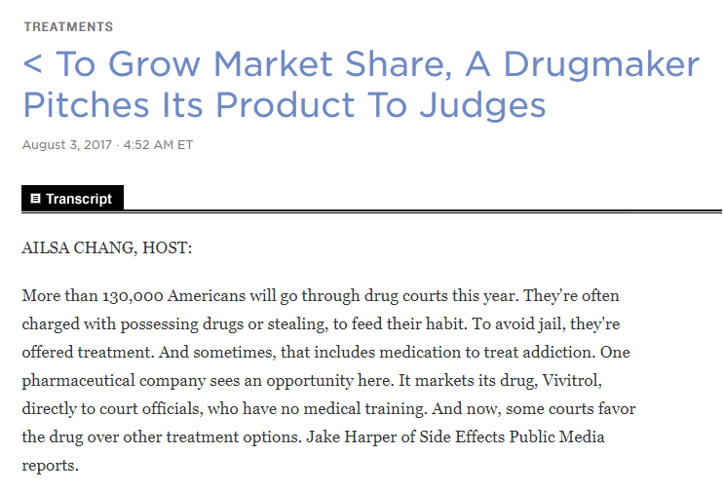
Law enforcement as new market?
Notes:
, and that the manufacturer has targeted criminal justice officials rather than doctors as a prime market. .

Slide 15
Back to Basics
Photo: Mainline
People’s needs, not system needs
Human values, not health interventions
Notes:
Can't work around people who use drugs--need to work with them. This means harm reduction is not a set of interventions, not a philosophy. Not evidence of HIV infections averted, but that joins the narratives of love, safety, family and community protection.

Slide 16
Dynamic and powerful, not static and contained
Thank you for your attention!

